Slide 1
HOTELSTARS Harmonized European classification system
8th SESSION OF THE HUNGARIAN-CROATIAN
WORKING GROUP ON TOURISM
18 June 2013
Lukács Attila
Hungarian Hotel & Restaurant Association

Slide 2
HOTELSTARS UNION
Strategic partnership – for hotel classification
Founding (December 2009.)
Founder members – Hotel Associations of 7 countries
Austria, Czech Republic, Germany, Hungary, Netherlands, Sweden, Switzerland,
Cooperation with HOTREC – EU member countries umbrella organization (Hotels Restaurants & Cafes)

Slide 3
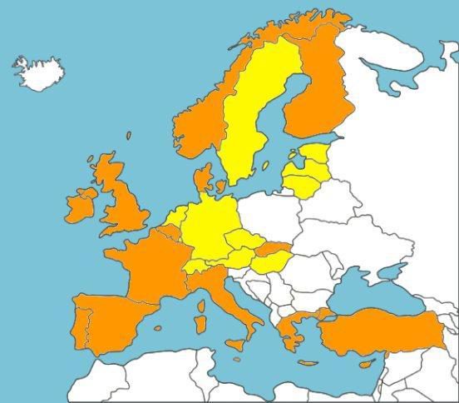
HOTREC
26 country
43 member association
- HOTREC countries
- HOTELSTARS UNION + HOTREC countries

Slide 4
HOTELSTARS UNION
Austria Belgium
Czech Republic
Denmark Estonia
Germany
Greece Hungary Latvia
Lithuania
Luxembourg
Malta
Netherlands
Switzerland
Sweden
150 million potential clients more, than 18.000 classified hotels

Slide 5
EXPANSION OF HOTELSTARS UNION
France, Spain, Italy – observer status, harmonization of criteria
Further interest in the HOTELSTARS system:
Middle-East countries
Turkey
South-America

Slide 6
Self audit
On-site control
Audit committee decision
Classification process:
4 year contract + HSU-National Label sign

Slide 7
Characteristics
Objective Y/N
Transparent – for the guests & hotels
On-line
Harmonized - within EU
Dynamic – (2010-2014) will be renewed from 2015
THE WINNER IS THE GUEST!

Slide 8
HOTELSTARS CRITERIA
5 category : 1*- 5* (superior)
270 criteria ( mandatory M, optional □) → 860 points
Succesful classification: different points by category & minimum number of criteria
Product and service elements audit
Wellness classification – specific in Hungary
Focus on quality management: proper complaint handling, Mystery guesting, EHQ

Slide 9
ADVANTAGE & RESULTS OF
HOTELSTARS
Harmonized criteria
Based on guest experiences → approach through the guest’s eye
For the hotels – competitiveness improvement
For the guests – quality improvement

Slide 10
HOTELSTARS UNION – HUNGARY
First classifications - November 2010.
Current status:
Hungary – 870 hotels
Registered : 479
Classified : 333
Previous system | HOTELSTARS
Based only on self-audit One-time Poor control – quality leeway | Self-audit, BUT … On-site control Valid for 4 years Voluntary Consumer Protection Authority control

Slide 11
Common operation of the classification system:
Ministry for National Economy Hungarian Hotel & Restaurant Association
Content:
HOTELSTARS – National Label
Unified metal sign → Hotelstars Union (Hotelstars Union, MNE - HHRA logo)
Quality level increase of hotels
Consumer protection/orientation

Slide 12
Fulfill criteria
+ Quality level increase
= Guaranteed success

Slide 13
E-mail: attila.lukacs@hah.hu
Web: www.hah.hu www.hotelstars.hu
Thank you for your attention!
E-mail: attila.lukacs@hah.hu
Web: www.hah.hu www.hotelstars.hu

